Slide 1
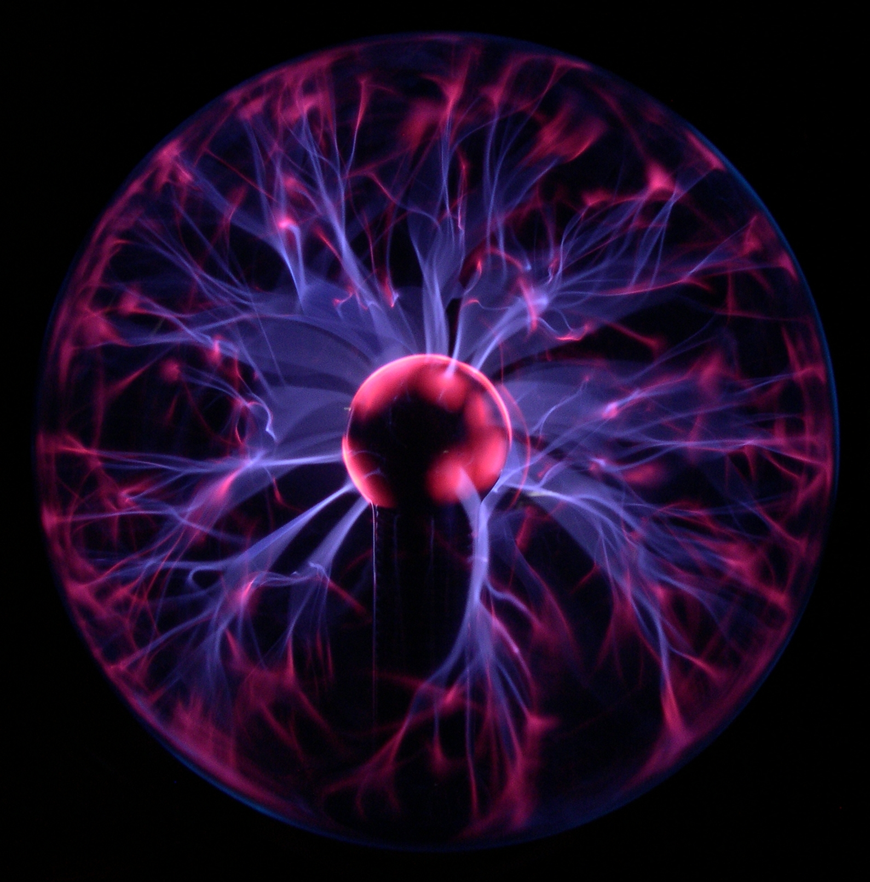
PSSA Physical Science Review
PSSA
Physical SCIENCE
REVIEW
We have 40 minutes to review 765 pages
of your book. Keep Calm and Carry on!
Franklin Regional Middle School Mr. Racchini

Slide 2
Things you should Know
Circuits (Series and Parallel)
Doppler effect
Reactants and Products
The Kinetic Theory of Matter
Buoyancy and Density
Acceleration, Velocity, Speed, Momentum
Acid, Bases and Salts
Protons, Neutrons, and Electrons
Covalent and Ionic Bonds
And much, much MORE!
Amplitude, Wave length, and Frequency
Catalyst
Solutions, Suspensions, and Colloids
Solids, Liquids, Gases, and Plasmas
Gas Laws (Boyles and Charles)
Boiling and Melting Points
Atom and Isotope
Displacement
pH
Centripetal Force
Thermal Expansion
Lens (Concave vs. Convex)
Elements and Compounds
Lever, Screw, Wedge, Pulley, Wheel & Axle
Newton’s Laws of Motion
Pressure
Energy (Potential vs. Kinetic)
Heat, Thermal Energy, and Temperature
Heat of Fusion / Vaporization
The Periodic Table
Physical vs. Chemical
Sonar

Slide 3
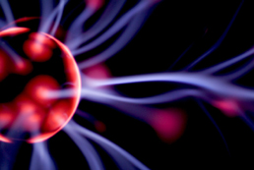
Let’s Start with some of the stuff we have already covered this year.
REMEMBER that Physical Science is the Study of two Things:
MATTER & ENERGY
According to the Dictionary, Physical Science is…
physical science
(Noun) 1. any of the natural sciences dealing with inanimate matter or with energy, as physics, chemistry, and astronomy.

Slide 4
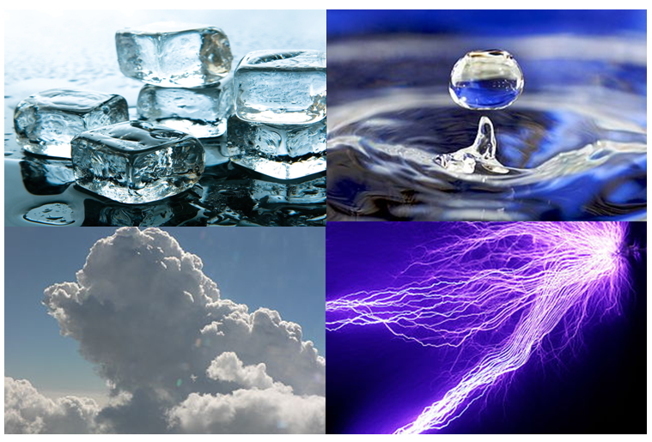
What’s the Matter with you?
There are FOUR States that matter can be:
SOLID
LIQUID
GAS
PLASMA
The state of matter is determined simply by the amount of ENERGY that the object’s molecules have

Slide 5
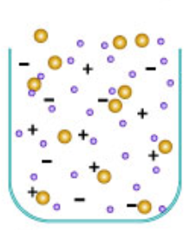
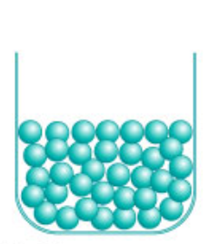
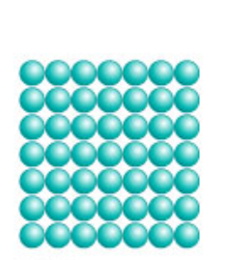
What’s the Matter with you?
The Molecules of Gas have finally gained enough energy to break free of attractive forces between the molecules and now move freely in any direction.
The Molecules of Liquids have slightly more energy than solids, so they are able to change position, but the forces between them are still too strong and keep them from flying away.
The Molecules of Plasma have so much energy that their atoms lose their electrons which results in a mixture of positive and negative particles .
The Molecules of Solids are arranged in repeating patterns and do not change position

Slide 6
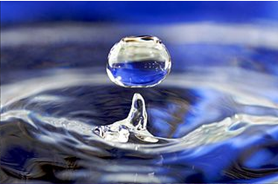
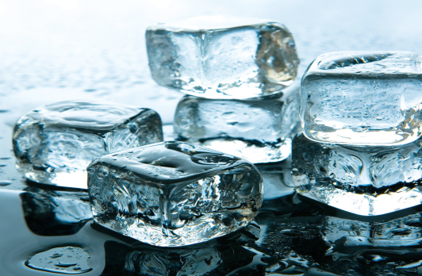
INCREASING ENERGY
Vaporization
GAS
Melting
Condensation
Liquid
Freezing
DECREASING ENERGY
Solid

Slide 7
What’s the Matter with you?
To correctly understand Matter, one must be able to first describe the matter’s properties and behaviors.
Charles Law
Viscosity
Density
Physical Properties
Boyles Law
Bernoulli’s Principle
Pascal’s Principle
Chemical Properties

Slide 8
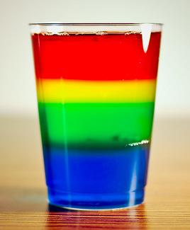
What’s the Matter with you?
ARE YOU DENSE or something?
Density describes the amount of Mass per unit of Volume (g/cm³)
Items with a greater Density will “SINK” in Fluids that are less dense.

Slide 9
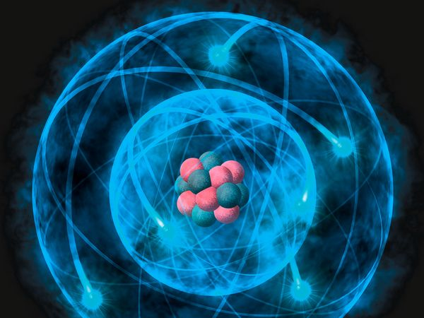
Up and Atom!
It’s time to get Elemental
Click on the Atom to find out
“How Small are Atoms?”
Electron Cloud
Electron
Nucleus
Proton
Neutron

Slide 10
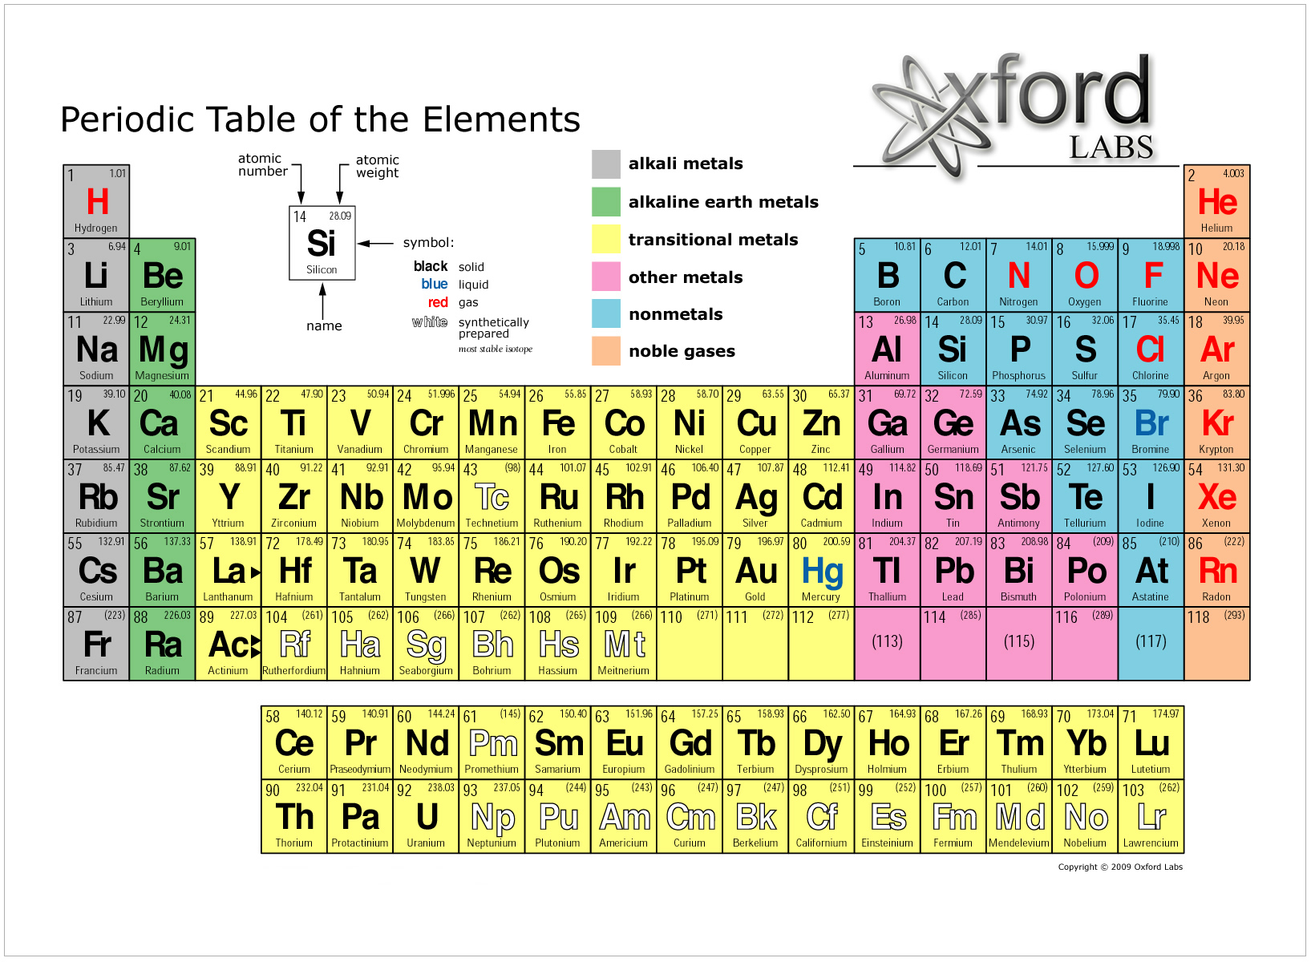
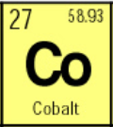
Up and Atom!
It’s time to get Elemental
Atomic Number
The number of protons in the nucleus of the atom.
Average
Atomic Mass
Average weight of all naturally occurring isotopes of the element
(Measured in AMU)
Electrons
The number of electrons must EQUAL the number of protons in order to maintain a Neutral electrical Charge
Neutrons
The number of neutrons can be found by subtracting the Atomic number from the mass of the isotope

Slide 11
What is N er G
(ENERGY)
The law of conservation of energy :
Energy cannot be created or destroyed. It can only be converted from one form to another OR transferred from one place to another.
Hot
(High Energy)
Cold
(Low Energy)
How is the Energy being transferred in this picture?
Energy Transfer is ALWAYS from HIGH to LOW

Slide 12
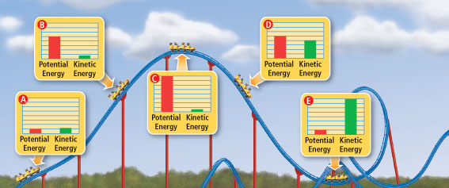
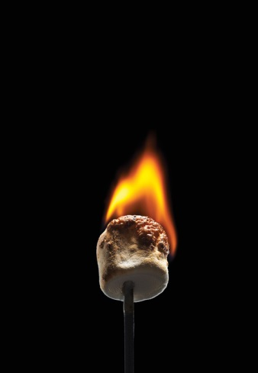
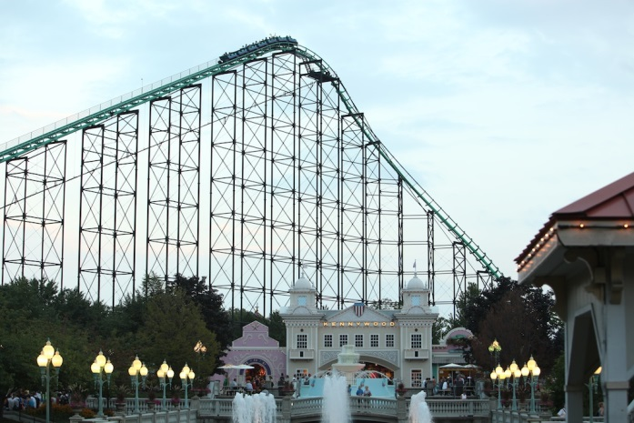
What is N er G
(ENERGY)
There are several different forms of energy:
Kinetic Energy: is energy due to motion
Potential Energy: is energy that is stored due to the interactions between objects
Mechanical Energy: is the sum of any kinetic energy, elastic and gravitational potential energy in a system
KE = ½ Mass x Speed²
(Measured in joules)
(Elastic PE, Chemical PE, or Gravitational PE)
GPE = Mass x Gravity x Height

Slide 13
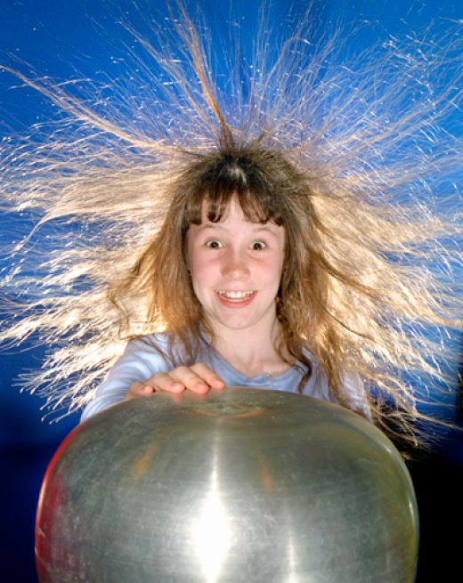
It’s Electric!
Boogie Woogie Woogie
The law of conservation of charge :
Electrical charges cannot be created or destroyed, but can be transferred from one object to another.
The electrons move up the generator to the metal ball and into the person.
Since all of the electrons are the same charge, they repel each other and try to get as far away from each other as possible.
Some electrons are bound more tightly to some atoms than others and can transfer to another object.
Van de Graaff generators work great at separating these electrons.

Slide 14
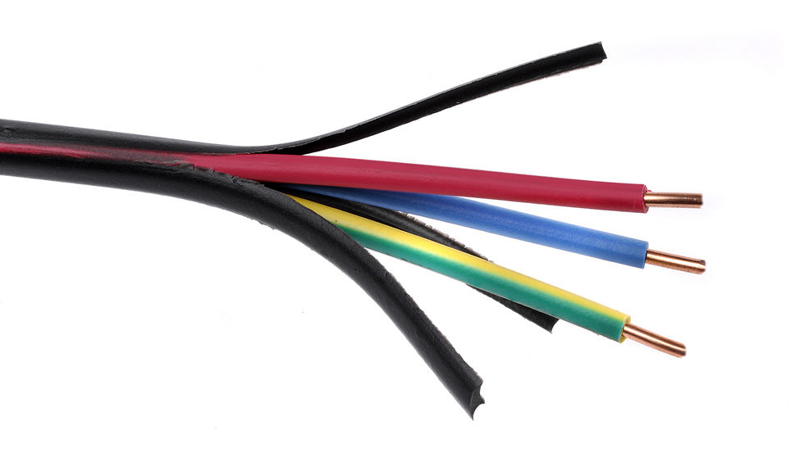
It’s Electric!
Boogie Woogie Woogie
Insulators: any material in which electrons are not able to move though easily. (The Plastic Coating around the wires)
Conductors: any material through which electrons move easily. (THE COPPER WIRE)

Slide 15
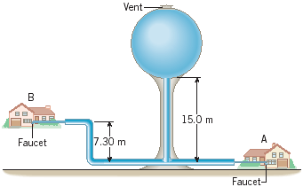
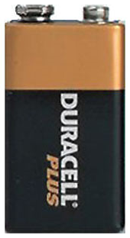
It’s Electric!
Boogie Woogie Woogie
What is Voltage?
It is the Potential Energy of electricity
The Voltage of electricity is much like the Potential of a water tower
Voltage is measured in Volts = which expresses how much energy a unit of charge will receive (or expend) if it is moved from one location at one voltage to another location at another voltage (Just like other Potential Energies)
9 V
9 V
9 V
High Water Potential
LOW Water Potential
High Voltage
LOW Voltage

Slide 16
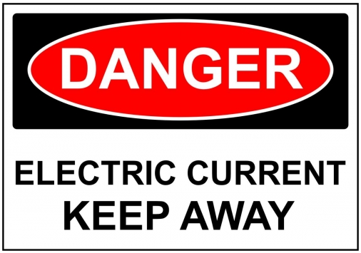
It’s Electric!
Boogie Woogie Woogie
What is Electric Current?
It is the NET (Overall) movement of electric charges in one direction
Measured in AMPS = The number of Coulombs (C) moving past a single point every second
1 Coulomb of electric Charge = 6,250 MILLION–BILLION electrons

Slide 17
Low Water flow because:
Resistance is high(the pipe is small) &
There is not enough pressure (Value is closed)
The Current of electricity is much like the FLOW of water through a pipe
Low Electrical Current because:
Resistance is high (3 light bulbs) &
There is not enough electrical pressure, Voltage. (Only one battery)
9 V

Slide 18
HIGH Water flow because:
2. There is LOTS of pressure (Value is OPEN)
HIGH Water flow because:
Resistance is LOW (the pipe is LARGER)
HIGH Electrical Current because:
2. There is LOTS of electrical pressure, Voltage. (3 batteries)
HIGH Electrical Current
because:
Resistance is LOW (only 1 light bulbs)
9 V
9 V
9 V
9 V
9 V

Slide 19
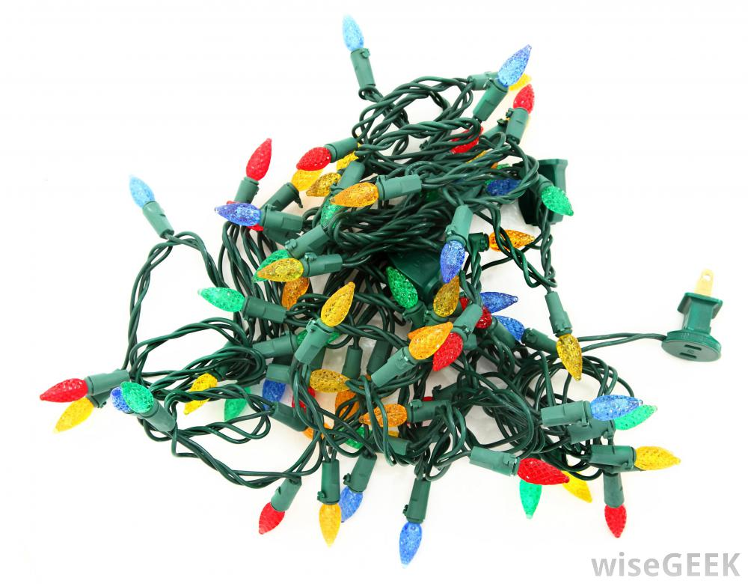
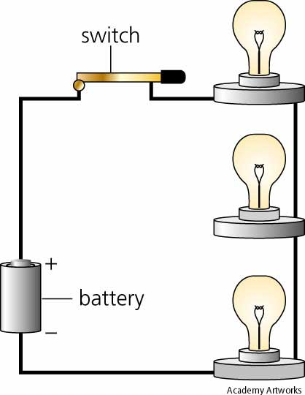
It’s Electric!
Boogie Woogie Woogie
There are two types of Circuits:
Circuits are a closed conducting loops through which electric current can flow.
Series Circuits = An electrical circuit with only one branch
If one bulb goes out the whole string goes out because there is a break in the circuit

Slide 20
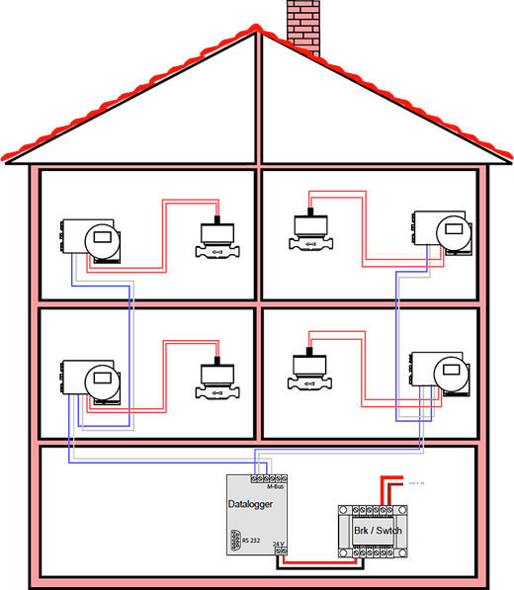
It’s Electric!
Boogie Woogie Woogie
Parallel Circuits
An electrical circuit that contains two or more branches
Your House is wired this way:
If one light goes out the others will stay on

Slide 21
See no Evil
Hear no Evil
Speak no Evil
WITHOUT WAVES!
A wave is a repeating disturbance that transfers energy through matter or space.
(Light and Sound)

Slide 22
Some WAVES might not sound great, so try not to make light of their situation
There are 2 main types of Waves
Transverse waves = The particles in the medium move back and forth at RIGHT ANGLES to the direction that the wave is traveling
Longitudinal waves = The particles in the medium move back and forth along the SAME DIRECTION that the wave is traveling

Slide 23
Some WAVES might not sound great, so try not to make light of their situation
Transverse Wavelength = the distance from crest to crest or trough to trough
Longitudinal Wavelength = can be measured from compression to compression or rarefaction to rarefaction
Compressions
Crests
Rarefactions
Troughs

Slide 24
Some WAVES might not sound great, so try not to make light of their situation
Frequency of a wave = the number of wavelengths that pass a fixed point each second (measured in Hertz [Hz])
Period of a wave = the amount of time it takes one wavelength to pass a point (in seconds)

Slide 25
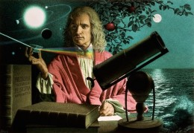
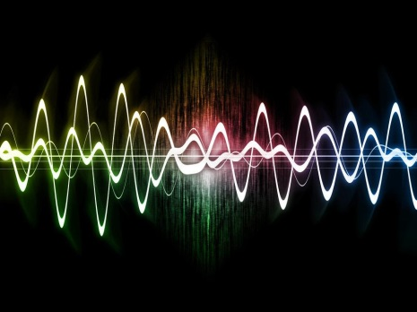
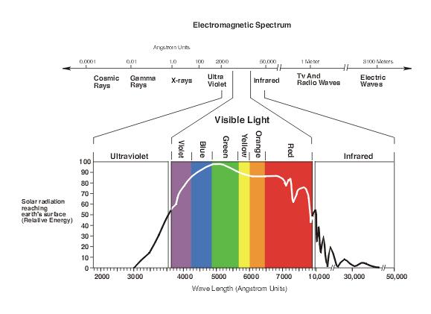
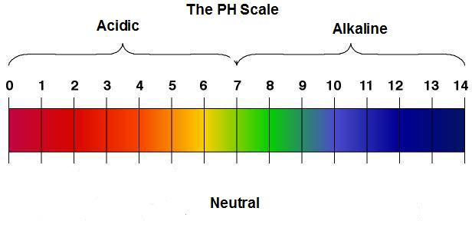
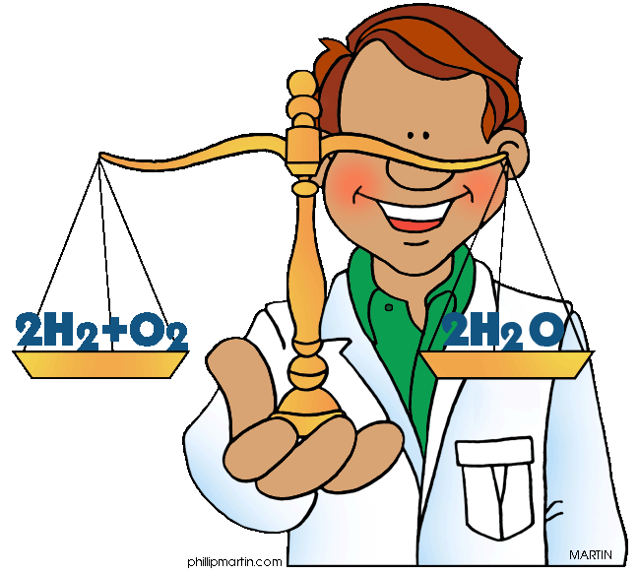
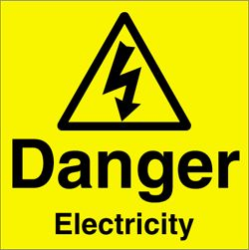
Click here to view his video on Newton’s Three Laws of Motion
Physical Science
Click here to view his video on Light
Click here to view his video on Sound waves
I have selected some videos from Paul Anderson. He was the 2011 Montana Teacher of the Year, and was also one of four finalists for the 2011 National Teacher of the Year. Just click on any image below to expand your understanding of
some of the topics of Physical Science
#2 Use the Internet and YouTube to watch videos on various Physical Science Topics.
If you want to learn more about anything you saw today,
do one of the following:
This slideshow was meant to just refresh your memory.
#1 Read chapters 1– 24 in your Physical Science book.
Click here to view his video on how to Balance Chemical Equations
Click here to view his video on Speed, Velocity, and Acceleration
Click here to view his video on the Voltage, Current, and Resistance
Click here to view his video on Acids, Bases, and pH

